Slide 1
Parent & family engagement
PCSD Stakeholders’ Meeting
Monday, October 23, 2017 6:30 pm
3236 Atlanta Hwy. Dallas, GA

Slide 2
Stakeholder feedback (May 1, 2017)
I would like to know more about…
Meaningful communication between teachers and parents
  Parent Engagement: definition, research, & meaningful communication
  Are we providing the information, opportunities, and resources we need to, so that parents are able to support their child’s academic success? What are the best ways for us to communicate, and share?
    Julie Ragsdale
    Executive Director Technology
Support for parents be more involved, especially in our challenged subgroups
    Angela Cammarano-Moses
    Parent Mentor

Slide 3
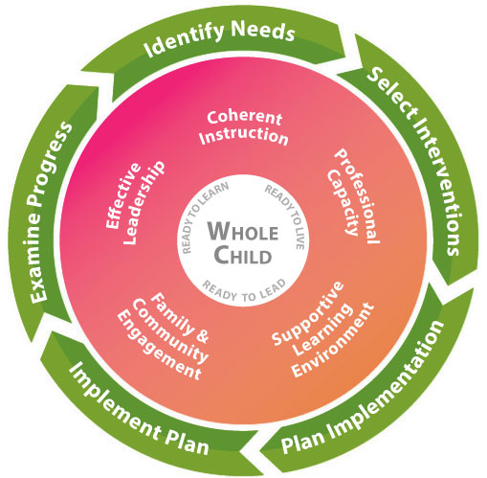
Georgia’s Systems of Continuous Improvement:
Essential Systems for School Improvement
Family & Community Engagement
…developing quality links between school professionals and the parents and community that school is intended to serve.
Six Structures of the Family and Community Engagement System
Welcoming All Families/Community
Communicating Effectively with Families and the Community
Supporting Student Success
Empowering Families
Sharing Leadership with Families and the Community
Collaborating with the Community

Slide 4
Parent & Family Engagement
Why?
If we as educators could successfully teach all children by ourselves, then we already would have done so. The clear fact that we have not yet successfully educated all children should be all the motivation necessary to embrace the concept of family engagement.
Steven Constantino
Founder and President of Family Friendly Schools

Slide 5
Family-School Engagement Matters:
Research
Attendance Improves
Grades Improve
Test Scores Improve
Student Attitudes and Behaviors Improve
Achievement Gap Closes
Faster Rates of Literacy Acquisition
Decreased Rates of School Drop Out

Slide 6
Official Definition
Georgia Department of Education
Parent & Family Engagement is an ongoing process that increases active participation, communication, and collaboration between parents, schools, and communities with the goal of educating the whole child to ensure student achievement and success

Slide 7
Actual Definition
Parents
Being a partner with my child’s teacher by talking with her, and my children, about what they are learning/doing in class, and attending school/teacher meetings and being in communication with the teacher, so I know how to support my child.
Teachers
Working together to best serve students through open communication from home to school and vice versa. Providing helpful information for how parents can support their student at home. The most important aspect is communication.

Slide 8
Meta-Analysis of Current Research:
What do families that influence their child’s success do?
The strongest associations between type of parent involvement and academic achievement are, in order of influence:
Parents have high academic expectations for their children.
Parents develop and maintain communication with them about their expectations, school activities and schoolwork.
Parents promote the development of reading habits.
It’s really what’s happening at home environments that supports student success. It’s everyday enforcements of the value of education, sacrifice, and hard work that students come to internalize as high aspirations for themselves.

Slide 9
The Foundation of Meaningful Partnerships: COMMUNICATION
What do schools/districts that communicate effectively with families provide, so that high expectations can be established for students and meaningful family-school engagement is in place?

Slide 10
Sharing Information
Process
Curriculum descriptions and information on instructional programs
Homework & grading policies
Information on what students will be learning and expected to do in their grade, or course
Calendar of events & opportunities
Information on student safety
School & district websites
Student Handbook
Meetings and Events
  Curriculum Nights &
  various support meetings
Newsletters
Parent Resource Centers
Quarterly Stakeholder Meetings

Slide 11
Process
Home-School Collaboration
Updates on student progress, with timely notice when performance slips
Individual assessment results and interpretation of those results
Setting student goals
Social/behavior aspects
Established ways of communicating with teachers
Volunteer, observation opportunities
Parent-teacher conferences
Email, text, phone
Parent portal
Progress reports
Assessment reports
Monitoring of on-line academic activity
Parent surveys & other feedback/input opportunities

Slide 12
Inventory:
How can we help you?
Quick Survey & Feedback
3 Minutes

Slide 13
Paulding County
District
&
Schools
Website Resources
Julie Ragsdale
Executive Director Technology

Slide 14
Paulding County
District
&
Schools
Empowering Families
Angela Cammarano-Moses
Parent Mentor

Slide 15
Thank you!
Feedback & Input—next steps

